Slide 1
Poisson’s Equation and Fast Method

Slide 2
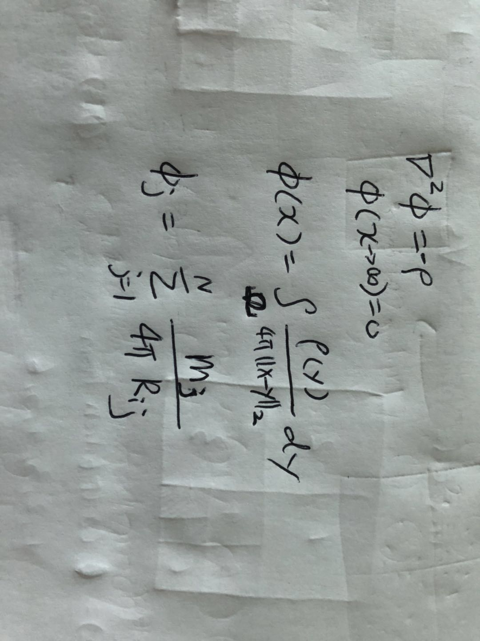
Poisson’s Euqation and its Fundamental Solution

Slide 3
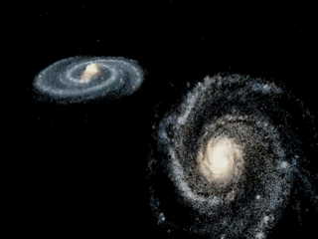

For Example: the Gravitational Problem
$f\left(x\right)=∇ϕ$
$$f\left(x\right)=−\sum_{j=1,j≠i}^{N}{∇_{x_{i}}\left(\frac{ρ_{j}v_{j} }{4π{\left\|x_{i}−x_{j}\right\|}_{2}^{}}\right)}$$
$$f_{i}=−\sum_{j=1,j≠i}^{N}{\frac{ρ_{j}v_{j} (x_{i}−x_{j})}{4π{\left\|x_{i}−x_{j}\right\|}_{2}^{3}}}$$
Given N particles and M evaluation position, direct computation requires O(NM) time!

Slide 4
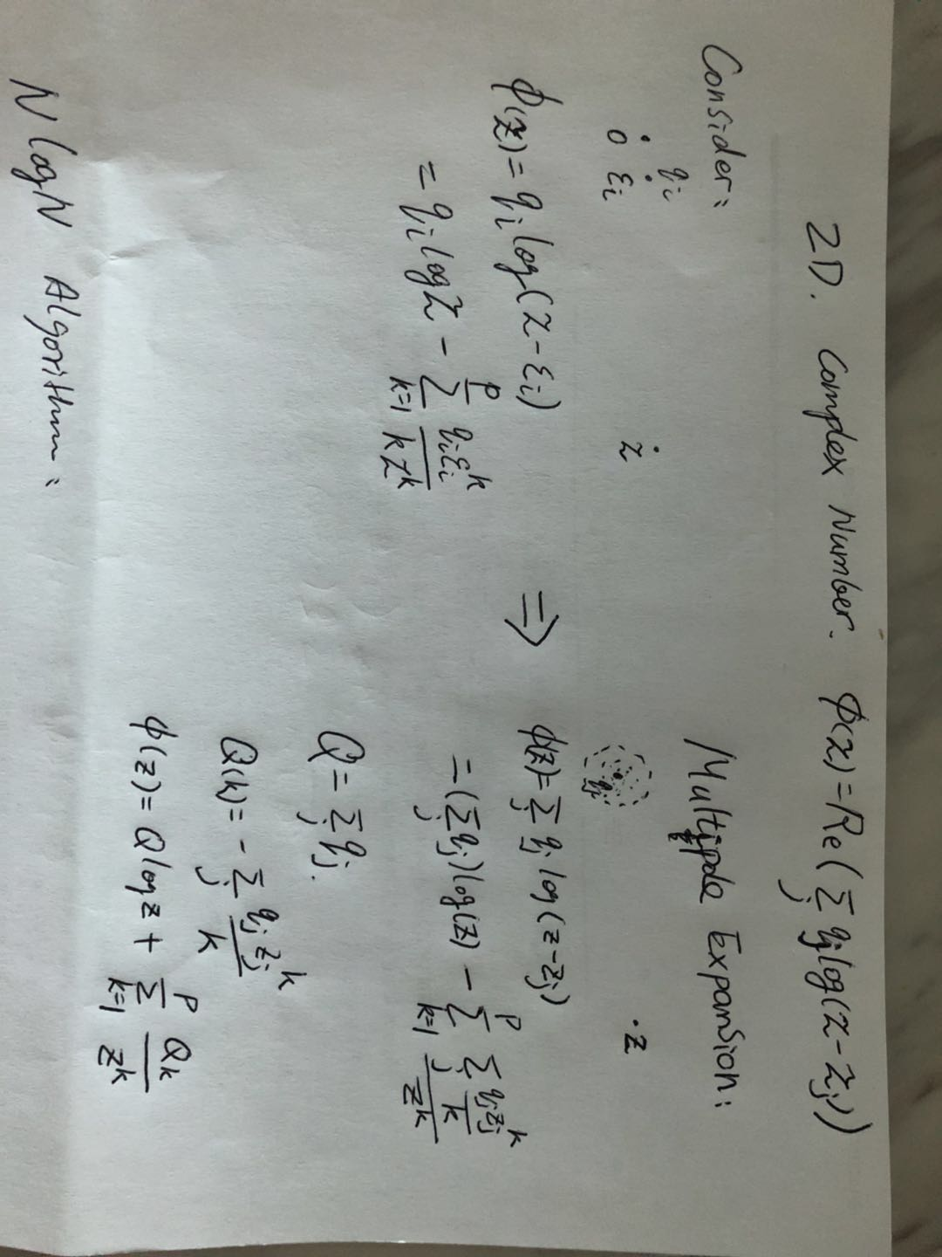
Introduction to Fast Summation
Consider a source and its potential
Multipole Expansion:
Apply Taylor expansion gives:

Slide 5
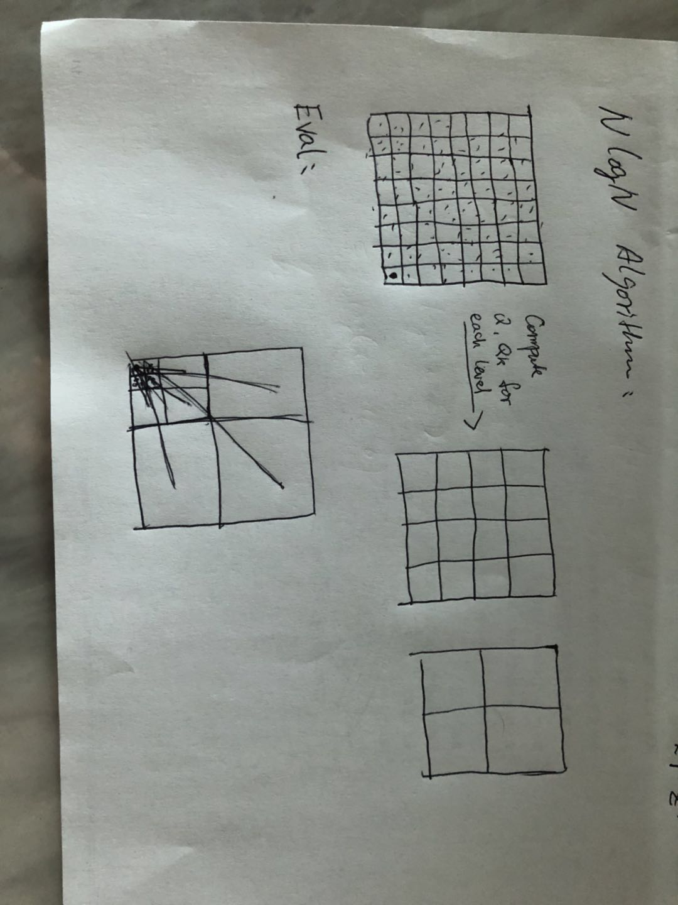
Tree Code

Slide 6
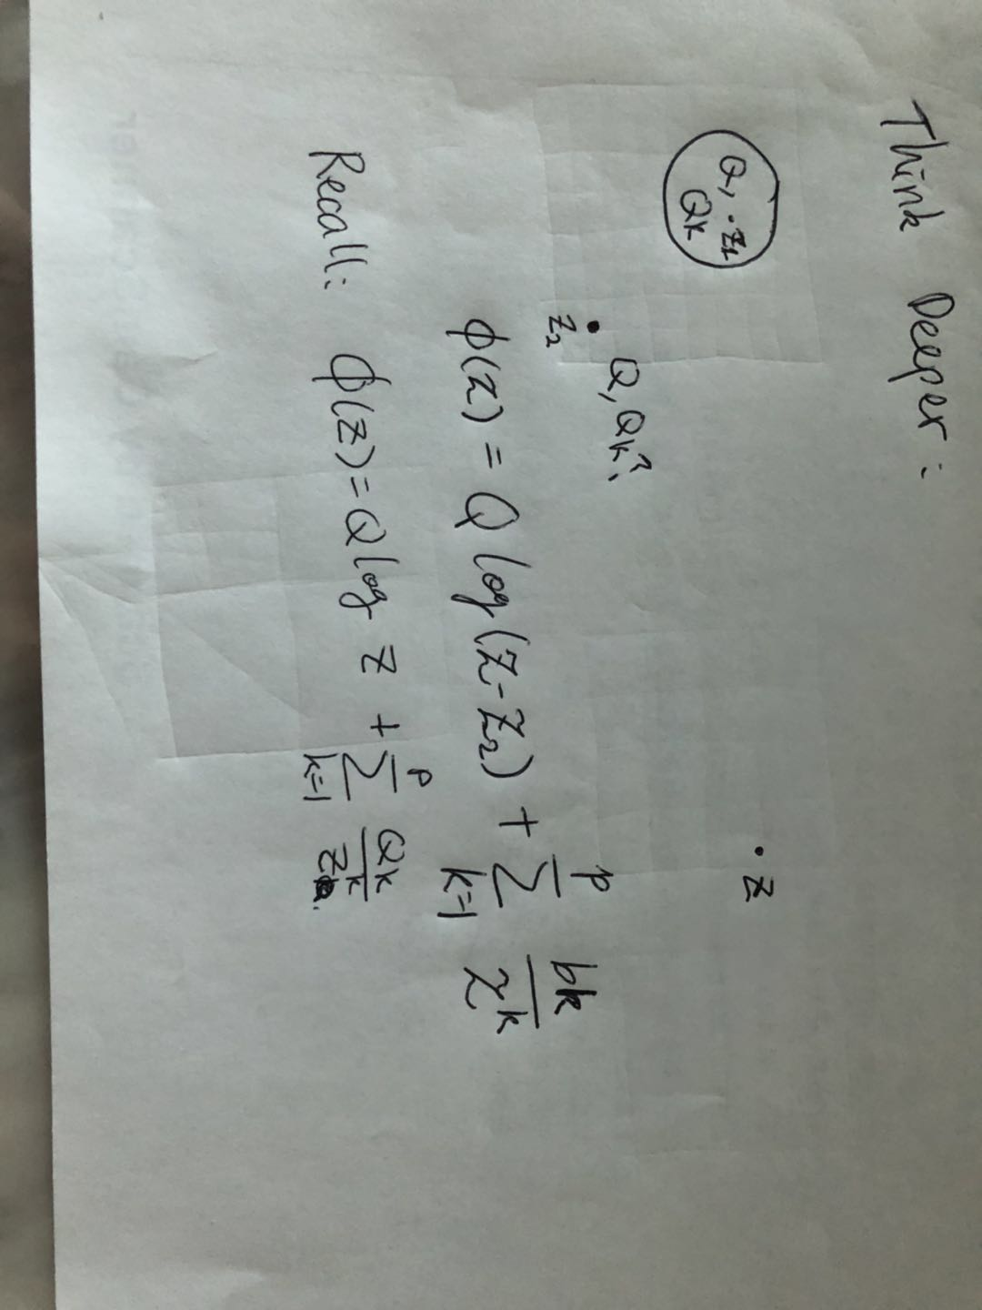
Take one step further:
If we know M-Expansion at z1 (M1={z1, Q, Q_k} ,
What is the M-Expansion at z2 (M2={z2, Q2, Q2_k}?
We want to obtain the coefficients from M1, not q_i’s

Slide 7
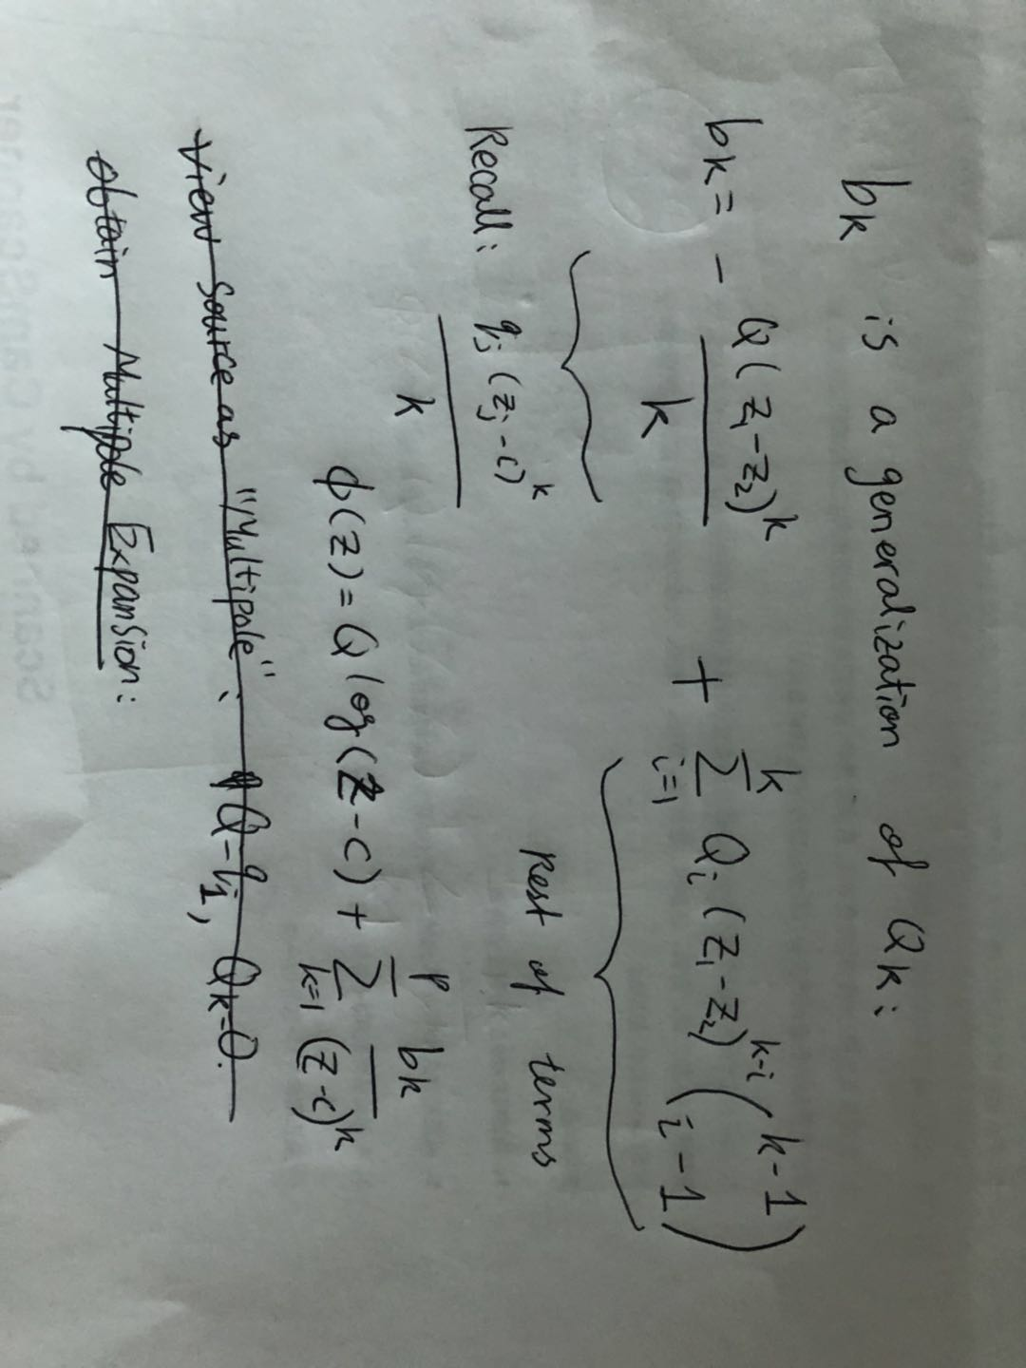

Slide 8
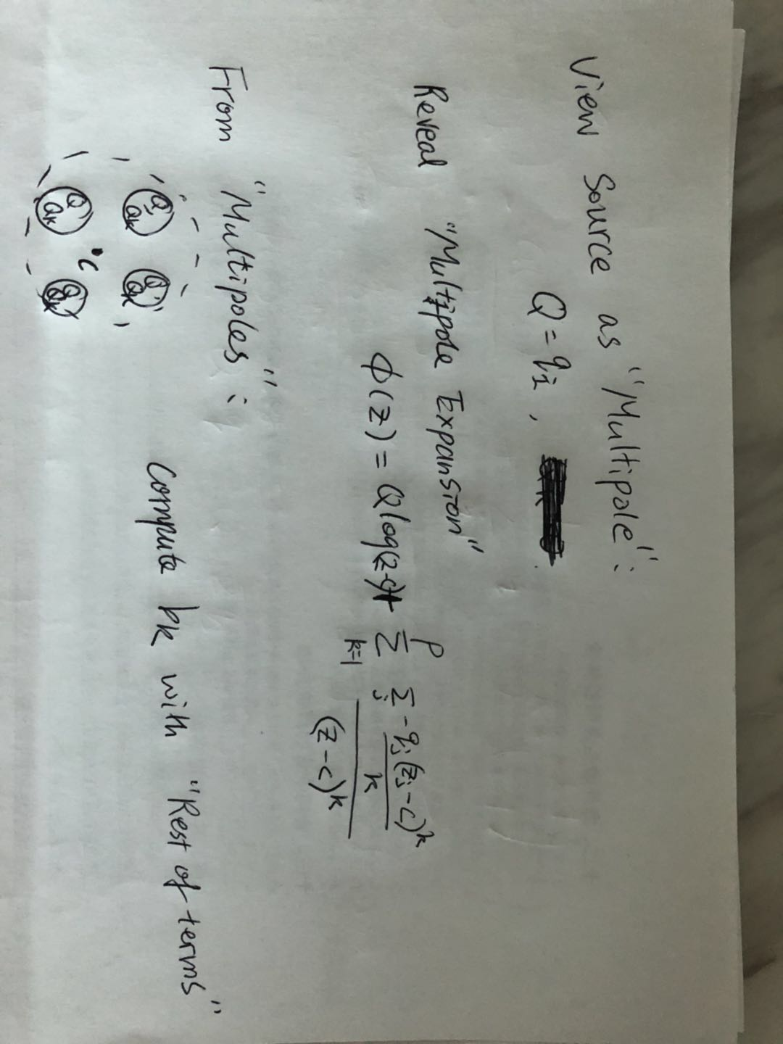
View Source as Multipole:
M2M Transform

Slide 9
struct Multipole{
vec2 center;
complex q[p];
};
//source charge is a special Multipole,
//with center = charge pos, q0 = qi, q1…q4 =0
Multipole M2M(std::vector<Multipole> &qlist)
{
Multipole res;
res.center = weightedAverageof(qlist[i].center*qlist[i].q[0]);
q[0] = sumof(qlist[i].q[0]);
for(k=1:p){
res.q[k]=0;
for(j=0:qlist.size()) {
res.q[k] += computeBk(qlist[i]);
}
}
return res;
}

Slide 10
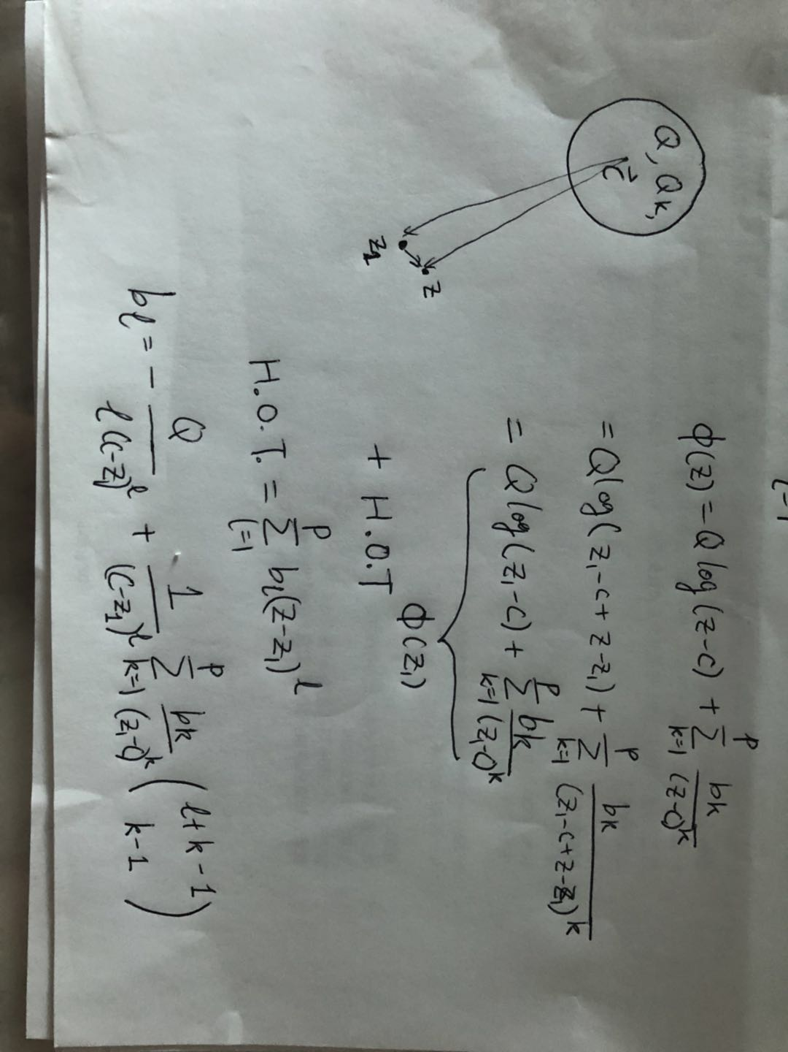
Question:
If we know M-Expansion at c1 (M1={c1, Q, Q_k} ,
What is the polynomial at z1, so that potentials at its neighbor z can be evaluated.
M2L Transform

Slide 11
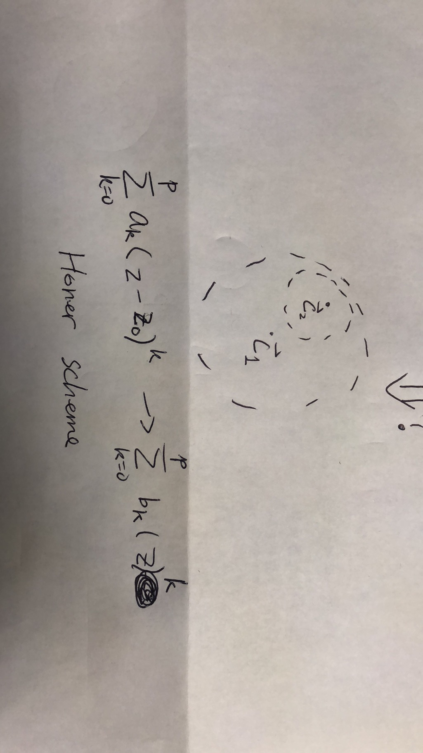
struct Localpole{
vec2 center;
complex b[p];
};
Question:
If we know L-Expansion at c1 (L1={c1, B} ),
What is the polynomial at c2, so that potentials at neighbor z around c2 can be evaluated.
L2L Transform

Slide 12
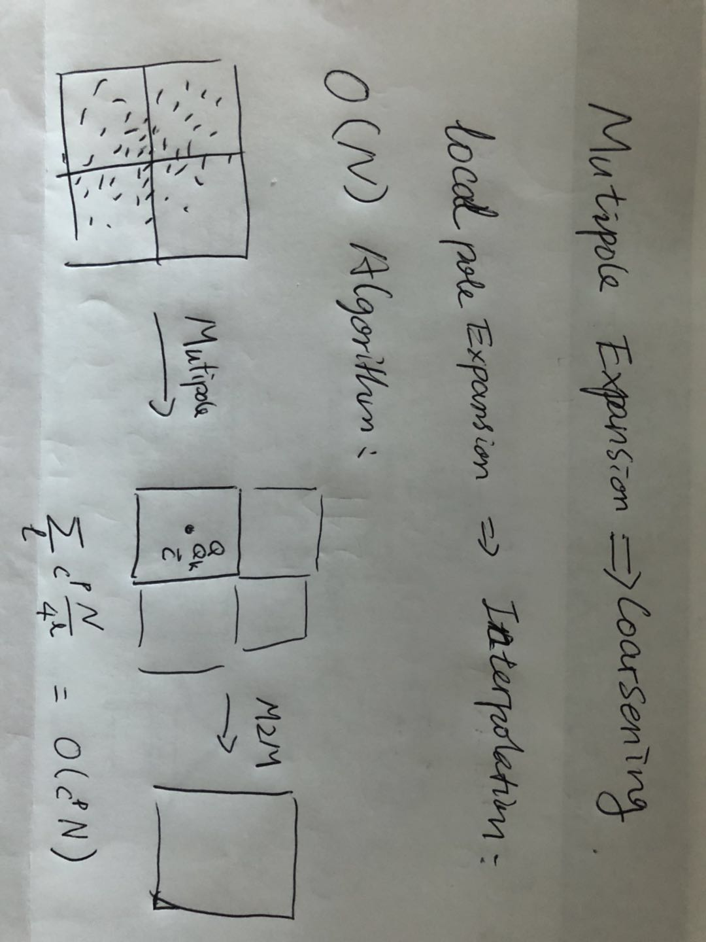
Multipole Expansion : Coarsening
Localpole Expansion : Interpolation

Slide 13
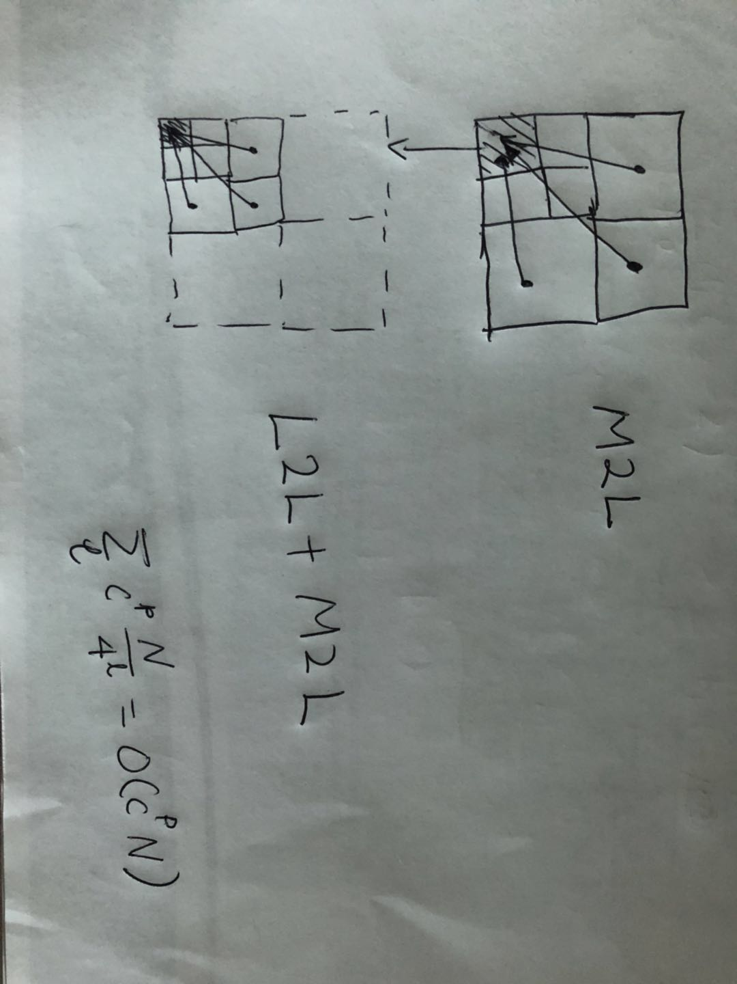

Slide 14
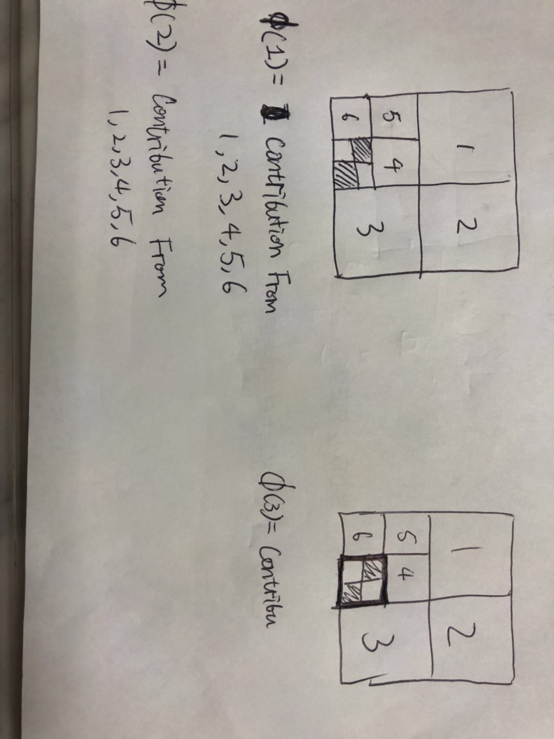
Tree code
VS
FMM
x1
x1
x2
x2
Phi(x1) = contribution from (node1, 2, 3, 4, 5, 6)
Phi(x2) = contribution from (node1, 2, 3, 4, 5, 6)
= contribution from (node1, 2, 3)
Phi(x1) = L2L from + contribution from (4, 5, 6)
Phi(x2) = L2L from + contribution from (4, 5, 6)

Slide 15
In 3D, the algorithm can be obtained via:
Taylor expansion of the Green’s function in Cartesian system
Taylor expansion of the Green’s function in Spherical coordinates
For more details, checkout:
https://math.nyu.edu/faculty/greengar/shortcourse_fmm.pdf

Slide 16
Many, Many important applications
Gravitational Force → Dark matter, cosmology…

Slide 17
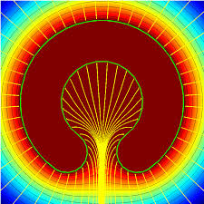
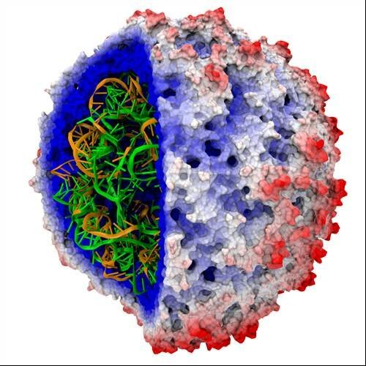

Electrostatic
$$∇^{2}φ=ερ$$
$$f=∇φ$$
Major force between moleculars!!
Cancer research
Drug Design
Virus Analysis

Slide 18
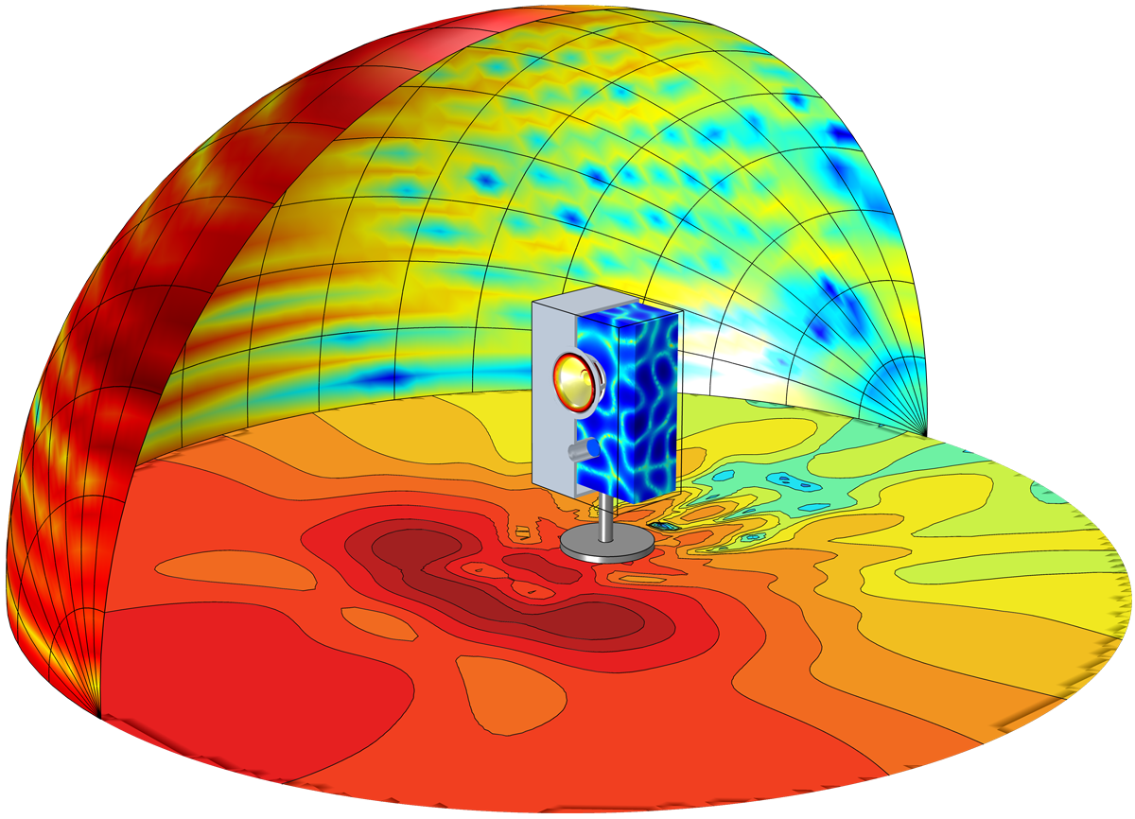
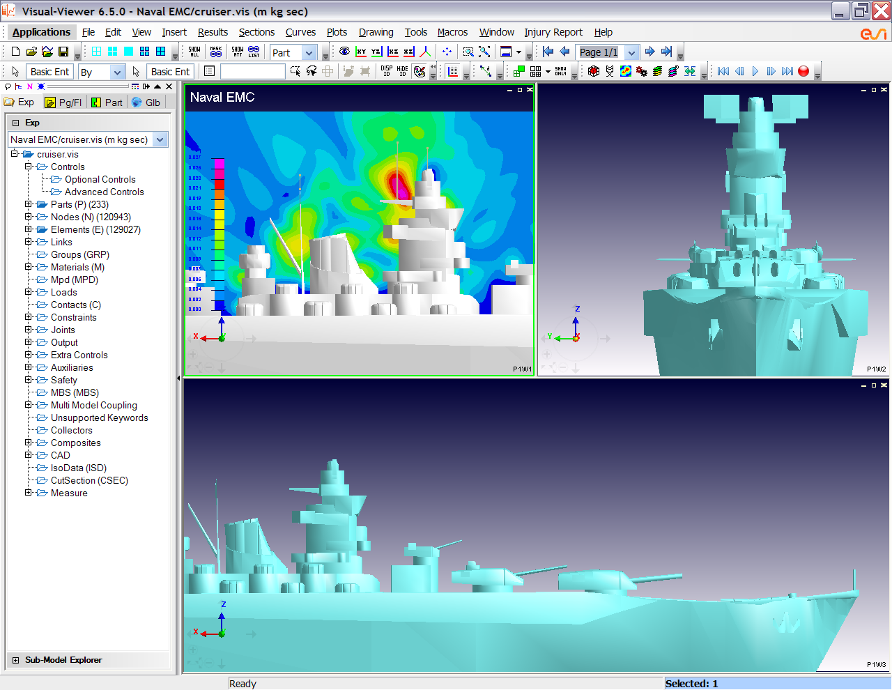

Helmholtz
$$∇^{2}φ+k^{2}φ=−f$$
Acoustics
Electromagnetic

Slide 19
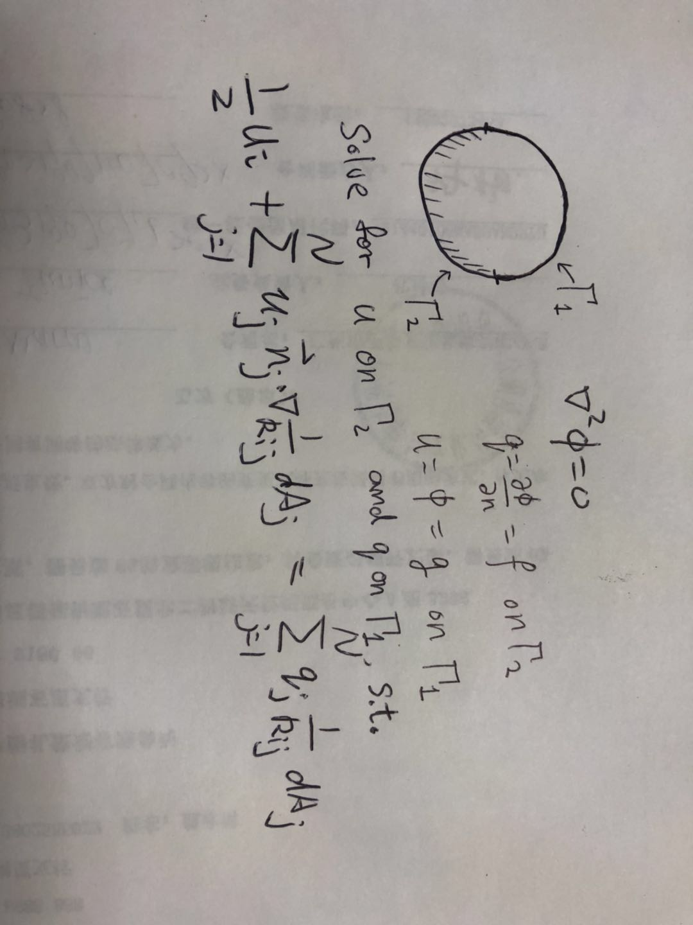
Boundary Element Method
PDE → Integral Equations
Matrix is Dense!
Condition number is Good!(usually converge in O(1) iterations)

Slide 20
Boundary Element Method
In 2D
Full Domain is N^2, with Multigrid Methods, O(N^2) computation.
Boundary element has N elements, BiCGSTAB method converges in constant iteration, and each iteration took O(N^2) for Dense Matrix-vector!
In 3D
Full Domain is N^3, with Multigrids, O(N^3)
Boundary element has N^2 elements, in total N^4 computation!
With FMM replacing the matrix vector multiplication operation
O(N) in 2D
O(N^2) in 3D.
Semi-Analytic!

Slide 21
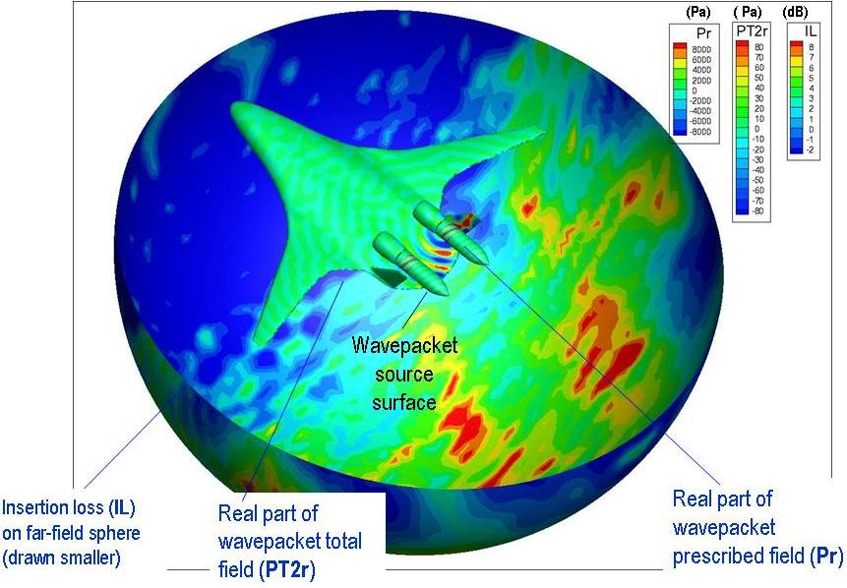
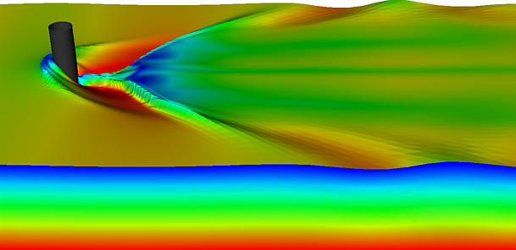
Large scale, deep wave
Sound Pressure

Slide 22
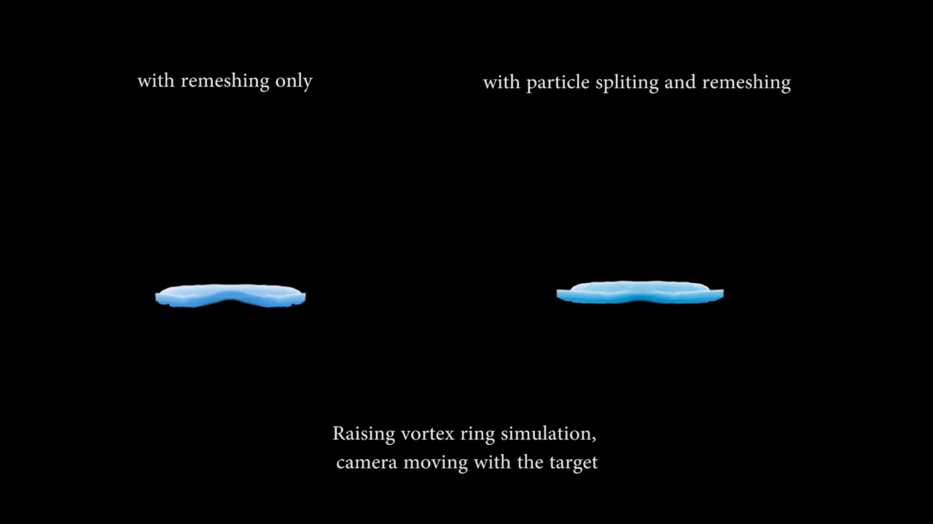


Vortex flow
$$u_{i}=\sum_{j=1,j≠i}^{N}{\frac{v_{j}ω_{j}×(x_{i}−x_{j})}{4π{\left\|x_{i}−x_{j}\right\|}_{2}^{3}}}$$
$$∇^{2}ψ=−ω$$
$$u=∇×ψ$$

Slide 23
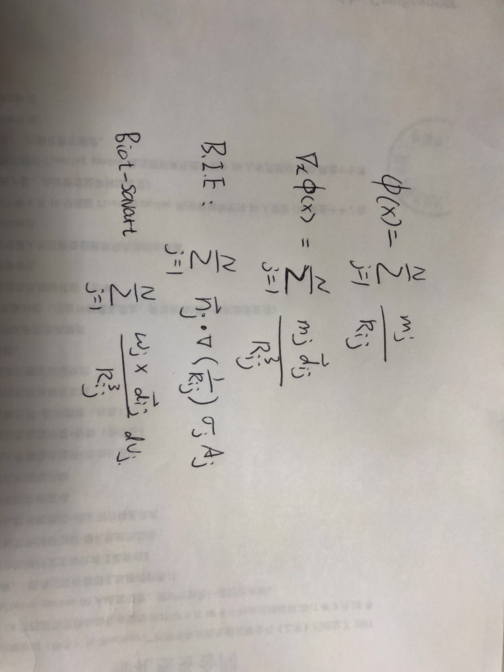
Type of summations

Slide 24
Compute them with same routine
Given Routine:
F = computeGradPhi(s); //returns gravity force using FMM from many source s
B.I.E:
Let s1[i] = n[i].x*s[i], s2[i] = n[i].y*s[i], s3[i] = n[i].z*s[i];
F1 = computeGradPhi(s1), F2 = computeGradPhi(s2), F3 = computeGradPhi(s3)
Res = F1.x + F2.y + F3.z;
Biot-Savart:
Your homework

Slide 25
Other fast summation methods:
PPPM

Slide 26


PPPM: Combining PDE form and summation forms
$$u_{i}=\sum_{j=1,j≠i}^{N}{\frac{v_{j}ω_{j}×(x_{i}−x_{j})}{4π{\left\|x_{i}−x_{j}\right\|}_{2}^{3}}}$$
$$∇^{2}ψ=−ω$$
$$u=∇×ψ$$
$$f_{i}=−ε\sum_{j=1,j≠i}^{N}{\frac{ρ_{j}v_{j} (x_{i}−x_{j})}{4π{\left\|x_{i}−x_{j}\right\|}_{2}^{3}}}$$
$$∇^{2}φ=ερ$$
$$f=∇φ$$
Direct summation for the turbulent part
Poisson’s Equation for the smooth part

Slide 27
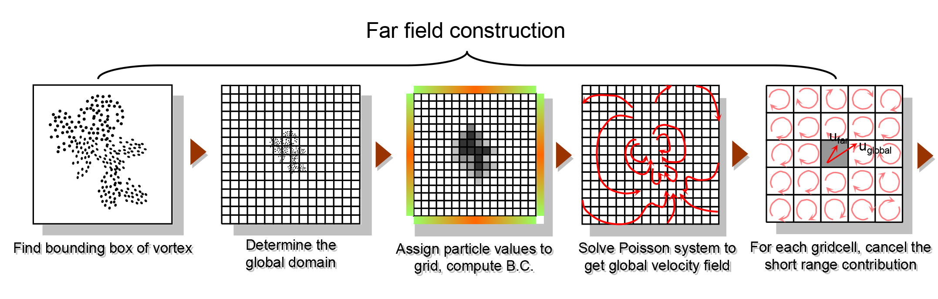
PPPM
Fast solution uses near-far decomposition to get acceleration. Can we do similar thing on a particle-mesh setup?
Notes:
In PPPM, vortex-in-cell is firstly used to compute a coarse velcotiy field, and then for each grid cell, the velocity contribution made by neighbor cells are carefully canceled.

Slide 28
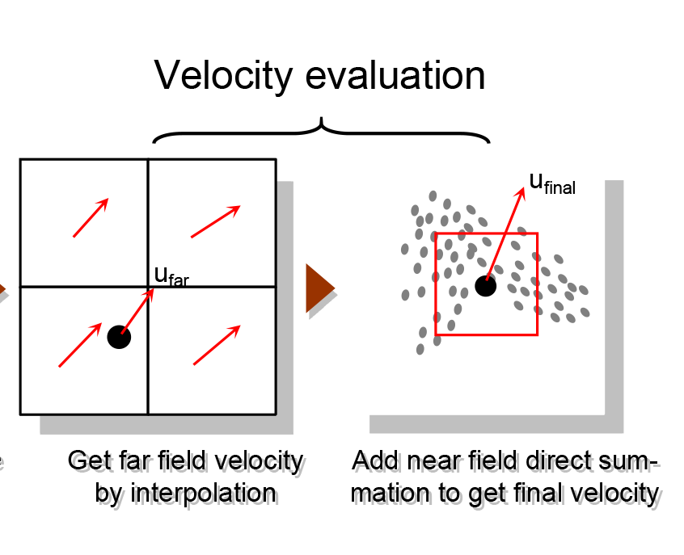
PPPM
Fast solution uses near-far decomposition to get acceleration. Can we do similar thing on a particle-mesh setup?
Notes:
One can then interpolate the far field value and do the near field direct summation to determine the particle velocity values.

Slide 29
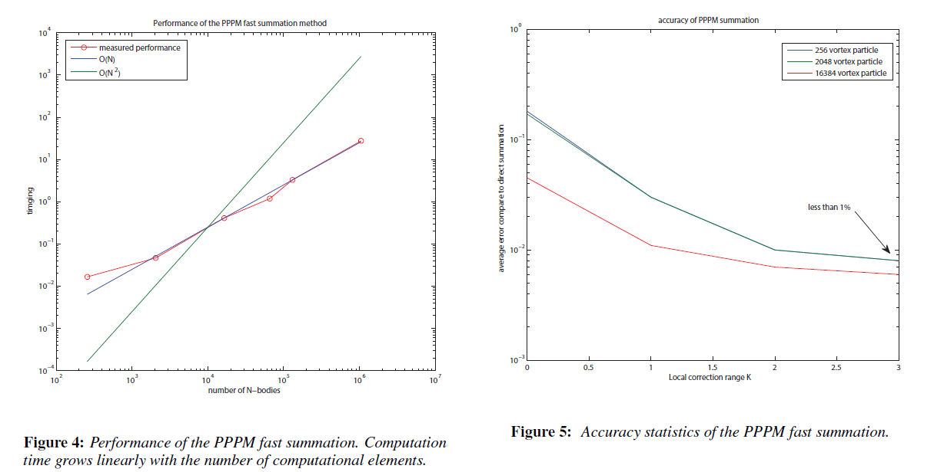
PPPM

Slide 30

Local Correction
In 3D, for a correction window of size K in each dimension, a local matrix of size $K^{3}×K^{3}$ can be precomputed to cancel the local influence from grid.
T(N) = O( c K^6 N)
Notes:
This process is called local correction, notice that for local correction, if we have a local window of size K, we have a computational constant propotional to K to the 6 power in front of the linear time summation

Slide 31
Local Correction
Notes:
To cancel this local errors, let’s put ourself in a conceptually infinity empty grid with a single grid cell impulse. This grid impulse will introduce a non-zero influence to near by grids.

Slide 32
Local Correction
The influence made by neighbor cells.
Notes:
If we take a back solve of this poisson problem, we get nonzero values as introduced by the local grid impulse .

Slide 33

Local Correction
The matrix inverse reveals how the center cell’s value depends linearly on its neighbors(including itself).
Notes:
If we do this again and again each time with different grid impulses, we can finally build a linear model to approximate local influences as made by local grid impulses.

Slide 34
PPPM in few lines
w_bar = particle_to_grid(w_p);
dw = w_p – interpolate(w_bar);
Psi = Poisson.Solve(w_bar);
v_smooth = curl(Psi);
v_p = interpolate(v_smooth) + nearSum(dw);
Notes:
That’s what we did in the 2014 paper, here I would like to give you a even simpler formula for the pppm summation,
Considering deconpose the velocity field into near- and far influences, which models the turbulent and smooth part respectively
We can find u smooth simply by interpolation of the particle mesh result,
And then add back the turbulent part of the flow with near field summation of the differences between particle vortex and vortex in cell values.

Slide 35
Summarize
Fast Summation Methods
FMM
PPPM
Equations solved by Fast Summation Methods:
Poisson’s Equation
Laplace Equation
Helmholtz Equation
BEM
Applications of Fast Summation Methods
Electrostatic::Molecular Dynamics::Cancer, drug design research
Magnetics::Ship design
Acoustics::Urban planning, vehicle shape design, theatre design
Potential flow::aircraft, wave
Vortex method::turbulent flow

